Slide 1
Introductory Statistics
Tenth Edition
Prem Mann
Chapter 4
Probability
This slide deck contains animations. Please disable animations if they cause issues with your device.
Copyright ©2021 John Wiley & Sons, Inc.

Slide 2
Opening Example
Are you a vegetarian? If not, do you know someone who is a vegetarian? What percentage of U.S. adults are vegetarians? According to a 2018 Gallup poll, 5% of all U.S. adults, aged 18 and older, are vegetarian. However, from the same poll, only 4% of U.S. adult men are vegetarian while 6% of U.S. adult women are vegetarian. Based on ideology, 2% of conservatives, 3% of moderates, and 11% of liberals are vegetarian. (See Case Study 4.1.)

Slide 3
4.1 Experiment, Outcomes, and Sample Space
Definition
An experiment is a process that, when performed, results in one and only one of many observations. These observations are called the outcomes of the experiment. The collection of all outcomes for an experiment is called a sample space.

Slide 4
Table 4.1 Examples of Experiments, Outcomes, and Sample Spaces
Experiment | Outcomes | Sample Space
Toss a coin once | Head, Tail | S = {Head, Tail}
Roll a die once | 1, 2, 3, 4, 5, 6 | S = {1, 2, 3, 4, 5, 6}
Toss a coin twice | HH, HT, TH, TT | S = {HH, HT, TH, TT}
Play lottery | Win, Lose | S = {Win, Lose}
Take a test | Pass, Fail | S = {Pass, Fail}
Select a worker | Male, Female | S = {Male, Female}

Slide 5
Example 4-1
Draw the tree diagram for the experiment of tossing a coin once.

Slide 6
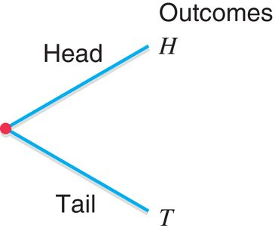
Example 4-1: Solution Figure 4.1 Tree Diagram for One Toss of a Coin

Slide 7
Example 4-2
Draw the tree diagram for the experiment of tossing a coin twice.

Slide 8
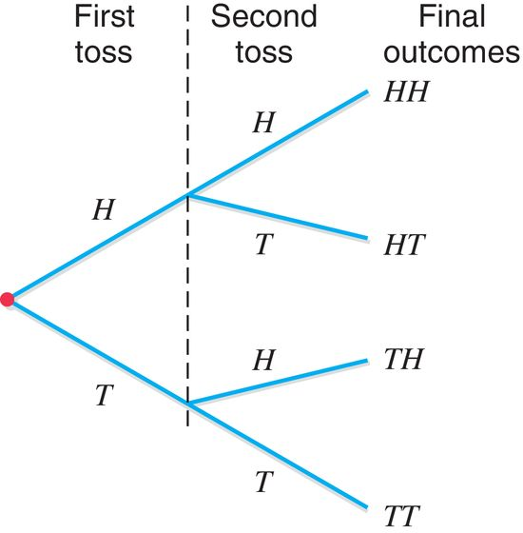
Example 4-2: Solution Figure 4.2 Tree Diagram for Two Tosses of a Coin

Slide 9
Example 4-3
Suppose we randomly select two workers from a company and observe whether the worker selected each time is a man or a woman. Write all the outcomes for this experiment. Draw the tree diagram for this experiment.

Slide 10
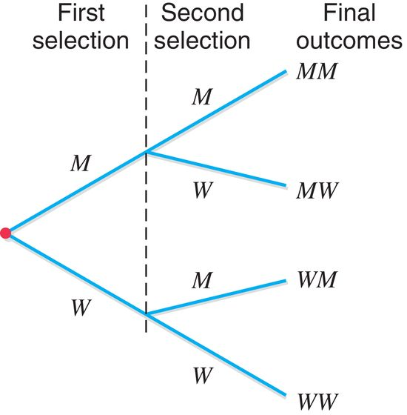
Example 4.3: Solution Figure 4.3 Tree Diagram for Selecting Two Workers

Slide 11
Event, Simple and Compound Events (1 of 3)
Definition
An event is a collection of one or more of the outcomes of an experiment.

Slide 12
Event, Simple and Compound Events (2 of 3)
Definition
An event that includes one and only one of the (final) outcomes for an experiment is called a simple event and is denoted by E_{i}.

Slide 13
Example 4-4
Reconsider Example 4-3 on selecting two workers from a company and observing whether the worker selected each time is a man or a woman. Each of the final four outcomes (MM, MW, WM, and WW) for this experiment is a simple event. These four events can be denoted by E₁, E₂, E₃, and E₄, respectively. Thus,
E₁ ={MM}, E₂ = {MW}, E₃ = {WM}, and E₄ = {WW}

Slide 14
Event, Simple and Compound Events (3 of 3)
Definition
A compound event is a collection of more than one outcome for an experiment.

Slide 15
Example 4-5
Reconsider Example 4-3 on selecting two workers from a company and observing whether the worker selected each time is a man or a woman. Let A be the event that at most one man is selected. Is event A a simple or a compound event?

Slide 16
Example 4-5: Solution
Here at most one man means one or no man is selected. Thus, event A will occur if either no man or one man is selected. Hence, the event A is given by
A = {MW, WM, WW
Because event A contains more than one outcome, it is a compound event. The diagram in Figure 4.4 gives a graphic presentation of compound event A.

Slide 17
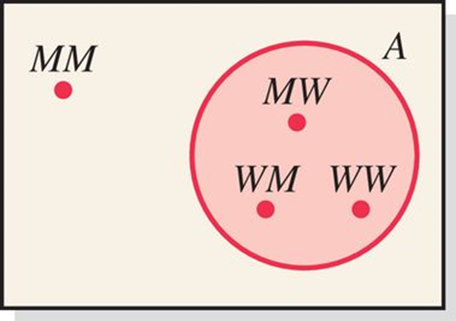
Figure 4.4 Diagram Showing Event A

Slide 18
Example 4-6
In a group of college students, some like ice tea and others do not. There is no student in this group who is indifferent or has no opinion. Two students are randomly selected from this group.
How many outcomes are possible? List all the possible outcomes.
Consider the following events. List all the outcomes included in each of these events. Mention whether each of these events is a simple or a compound event.
Both students like ice tea.
At most one student likes ice tea.
At least one student likes ice tea.
Neither student likes ice tea.

Slide 19
Example 4-6: Solution (1 of 6)
Let
L The event that a student likes ice tea
N The event that a student does not like ice tea
LL Both students like ice tea
LN The first student likes ice tea but the second student does not
NL The first student does not like ice tea but the second student does
LN Both students does not like ice tea

Slide 20
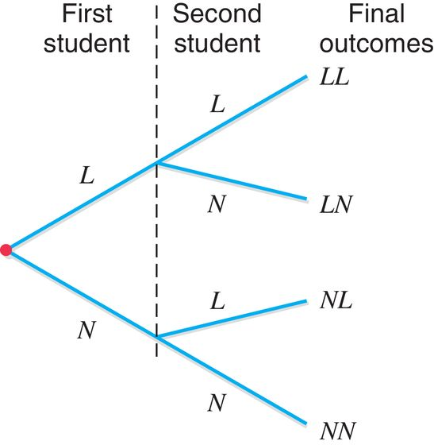
Figure 4.5 Tree Diagram

Slide 21
Example 4-6: Solution (2 of 6)
This experiment has four outcomes, which are listedbelow and shown in Figure 4.5.
LL, LN, NL, NN

Slide 22
Example 4-6: Solution (3 of 6)
(b)
The event both students like ice tea will occur if LL happens. Thus,
Both students like ice tea = {LL}
Since this event includes only one of the four outcomes, it is a simple event.

Slide 23
Example 4-6: Solution (4 of 6)
(b)
The event at most one student likes ice tea will occur if one or none of the two students likes ice tea, which will include the events LN, NL, and NN. Thus,
At most one student likes ice tea = {LN, NL, NN}
Since this event includes three outcomes, it is a compound event.

Slide 24
Example 4-6: Solution (5 of 6)
(b)
The event at least one student likes ice tea will occur if one or two of the two students like ice tea, which will include the events LN, NL, and LL. Thus,
At least one student likes ice tea = {L N, NL, LL}
Since this event includes three outcomes, it is a compound event.

Slide 25
Example 4-6: Solution (6 of 6)
(b)
The event neither student likes ice tea will occur if neither of the two students likes ice tea, which will include the event NN. Thus,
Neither student likes ice tea = {NN}
Since this event includes one outcome, it is a simple event.

Slide 26
4.2 Calculating Probability
Definition
Probability is a numerical measure of the likelihood that a specific event will occur.

Slide 27
Two Properties of Probability
The probability of an event always lies in the range 0 to 1.
First Property of Probability
0 ≤ P(E_{i}) ≤ 1
0 ≤ P(A) ≤ 1
The sum of the probabilities of all simple events (or final outcomes) for an experiment, denoted by ΣP(E_{i}), is always 1.
Second Property of Probability For an experiment
ΣP(E_{i}) = P(E₁) + P(E₂) + ∙∙∙ = 1

Slide 28
Three Conceptual Approaches to Probability (1 of 3)
Classical Probability
Definition
Two or more outcomes that have the same probability of occurrence are said to be equally likely outcomes.

Slide 29
Classical Probability
Classical Probability Rule to Find Probability

Slide 30
Example 4-7
Find the probability of obtaining a head and the probability of obtaining a tail for one toss of a coin.

Slide 31
Example 4-7: Solution
Similarly,

Slide 32
Example 4-8
Find the probability of obtaining an even number in one roll of a die.

Slide 33
Example 4-8: Solution
A = an even number is obtained = {2, 4, 6}.
If any one of these three numbers is obtained, event A is said to occur. Hence,

Slide 34
Example 4-9
Jim and Kim have been looking for a house to buy in New Jersey. They like five of the homes they have looked at recently and two of those are in West Orange. They cannot decide which of the five homes they should pick to make an offer. They put five balls (of the same size) marked 1 through 5 (each number representing a home) in a box and asked their daughter to select one of these balls. Assuming their daughter’s selection is random, what is the probability that the selected home is in West Orange?

Slide 35
Example 4-9: Solution
With random selection, each home has the same probability of being selected and the five outcomes (one for each home) are equally likely. Two of the five homes are in West Orange. Hence,

Slide 36
Three Conceptual Approaches to Probability (2 of 3)
Relative Frequency Concept of Probability
Using Relative Frequency as an Approximation of Probability
If an experiment is repeated n times and an event A is observed f times where f is the frequency, then, according to the relative frequency concept of probability:

Slide 37
Example 4-10
Ten of the 500 randomly selected cars manufactured at a certain auto factory are found to be lemons. Assuming that the lemons are manufactured randomly, what is the probability that the next car manufactured at this auto factory is a lemon?

Slide 38
Example 4-10: Solution
Let n denote the total number of cars in the sample and f the number of lemons in n. Then,
n = 500 and f = 10
Using the relative frequency concept of probability, we obtain

Slide 39
Table 4.2 Frequency and Relative Frequency Distributions for the Sample of Cars
Car | f | Relative Frequency
Good | 490 | 490/500 = .98
Lemon | 10 | 10/500 = .02
 | n = 500 | Sum = 1.00

Slide 40
Law of Large Numbers
Definition
Law of Large Numbers
If an experiment is repeated again and again, the probability of an event obtained from the relative frequency approaches the actual (or theoretical) probability.

Slide 41
Table 4.3 Simulating the Tosses of a Coin
Table 4.3 Simulating the Tosses of a Coin
Number of Tosses | Number of Heads | Number of Tails | P (H ) | P (T )
3 | 0 | 3 | .00 | 1.00
8 | 6 | 2 | .75 | .25
25 | 9 | 16 | .36 | .64
100 | 61 | 39 | .61 | .39
1000 | 522 | 478 | .522 | .478
10,000 | 4962 | 5038 | .4962 | .5038
1,000,000 | 500,313 | 499,687 | .5003 | .4997
If the experiment is repeated only a few times, the probabilities obtained may not be close to the actual probabilities. As the number of repetitions increases, the probabilities of outcomes obtained become very close to the actual probabilities.

Slide 42
Example 4-11
Allison wants to determine the probability that a randomly selected family from New York State owns a home. How can she determine this probability?

Slide 43
Example 4-11: Solution
There are two outcomes for a randomly selected family from New York State: “This family owns a home” and “This family does not own a home.” These two events are not equally likely. Hence, the classical probability rule cannot be applied. However, we can repeat this experiment again and again. Hence, we will use the relative frequency approach to probability.

Slide 44
Three Conceptual Approaches to Probability (3 of 3)
Subjective Probability
Definition
Subjective probability is the probability assigned to an event based on subjective judgment, experience, information, and belief. There are no definite rules to assign such probabilities.

Slide 45
4.3 Marginal Probability, Conditional Probability, and Related Probability Concepts
Suppose all 100 employees of a company were asked whether they are in favor of or against paying high salaries to CEOs of U.S. companies. Table 4.4 gives a two way classification of the responses of these 100 employees. Assume that every employee responds either in favor or against.

Slide 46
Table 4.4 Two-Way Classification of Employee Responses
 | In Favor | Against
Male | 15 | 45
Female | 4 | 36

Slide 47
Table 4.5 Two-Way Classification of Employee Responses with Totals
 | In Favor | Against | Total
Male | 15 | 45 | 60
Female | 4 | 36 | 40
Total | 19 | 81 | 100

Slide 48
Marginal Probability, Conditional Probability, and Related Probability Concepts (1 of 6)
Definition
Marginal probability is the probability of a single event without consideration of any other event.

Slide 49
Table 4.6 Listing the Marginal Probabilities
Table 4.6 Listing the Marginal Probabilities
 | In Favor (A) | Against (B) | Total
Male (M) | 15 | 45 | 60
Female (F) | 4 | 36 | 40
Total | 19 | 81 | 100
P(M) = 60/100 = .60
P(F) = 40/100 = .40
P(A) = 19/100 = .19
P(B) = 81/100 = .81

Slide 50
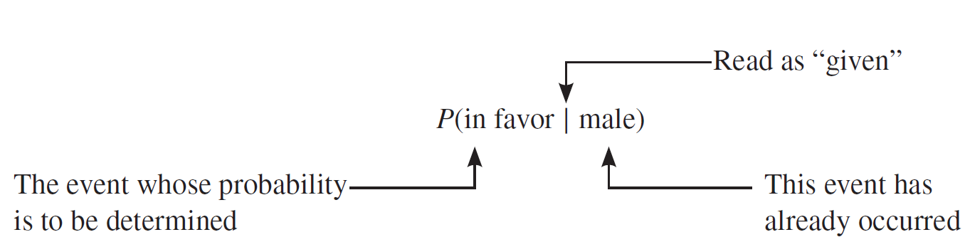
Marginal Probability, Conditional Probability, and Related Probability Concepts (2 of 6)

Slide 51
Marginal Probability, Conditional Probability, and Related Probability Concepts (3 of 6)
Definition
Conditional probability is the probability that an event will occur given that another has already occurred. If A and B are two events, then the conditional probability of A given B is written as
P ( A | B )
and read as “the probability of A given that B has already occurred.”

Slide 52
Example 4-12
Compute the conditional probability P (in favor | male) for the data on 100 employees given in Table 4.5.

Slide 53
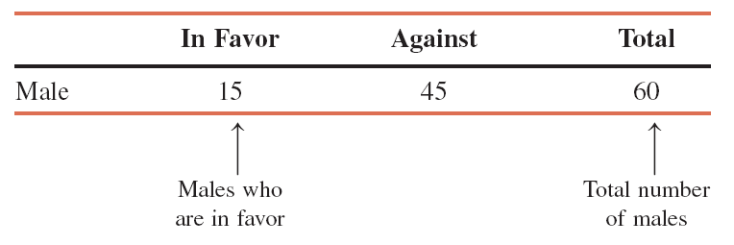
Example 4-12: Solution

Slide 54
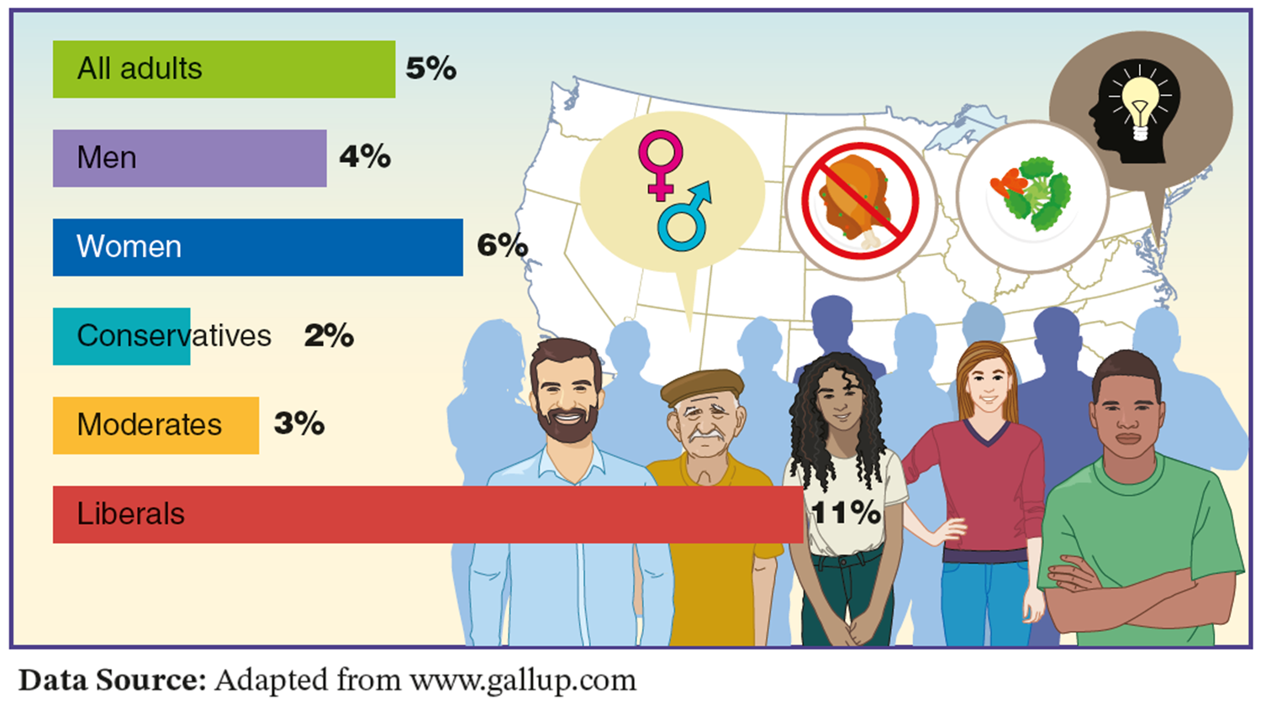
Case Study 4-1 Vegetarians, Gender, and Ideology
Data Source: Adapted from www.gallup.com

Slide 55
Example 4-13
For the data of Table 4.5, calculate the conditional probability that a randomly selected employee is a female given that this employee is in favor of paying high salaries to CEOs.

Slide 56
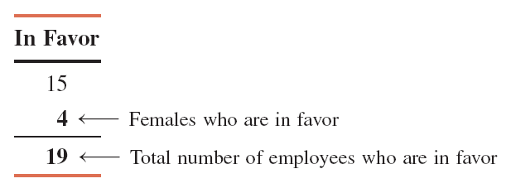
Example 4-13: Solution

Slide 57
Marginal Probability, Conditional Probability, and Related Probability Concepts (4 of 6)
Definition
Events that cannot occur together are said to be mutually exclusive events.

Slide 58
Example 4-14
Consider the following events for one roll of a die:
A= an even number is observed= {2, 4, 6}
B= an odd number is observed= {1, 3, 5}
C= a number less than 5 is observed= {1, 2, 3, 4}
Are events A and B mutually exclusive? Are events A and C mutually exclusive?

Slide 59
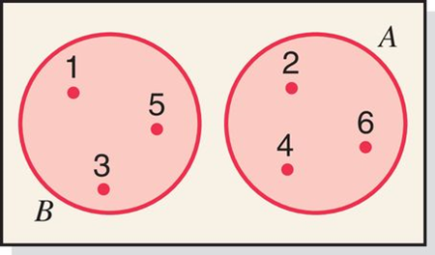
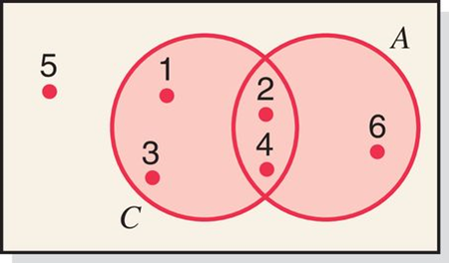
Example 4-14: Solution (1 of 2)
Mutually exclusive events A and B
Mutually nonexclusive events A and C

Slide 60
Example 4-14: Solution (2 of 2)
We can observe from the definitions of events A and C and from Figure 4.7 that events A and C have two common outcomes: 2-spot and 4-spot. Thus, if we roll a die and obtain either a 2-spot or a 4-spot, then A and C happen at the same time. Hence, events A and C are not mutually exclusive.

Slide 61
Example 4-15
Consider the following two events for a randomly selected adult:
Y = this adult has shopped on the Internet at least once
N = this adult has never shopped on the Internet
Are events Y and N mutually exclusive?

Slide 62
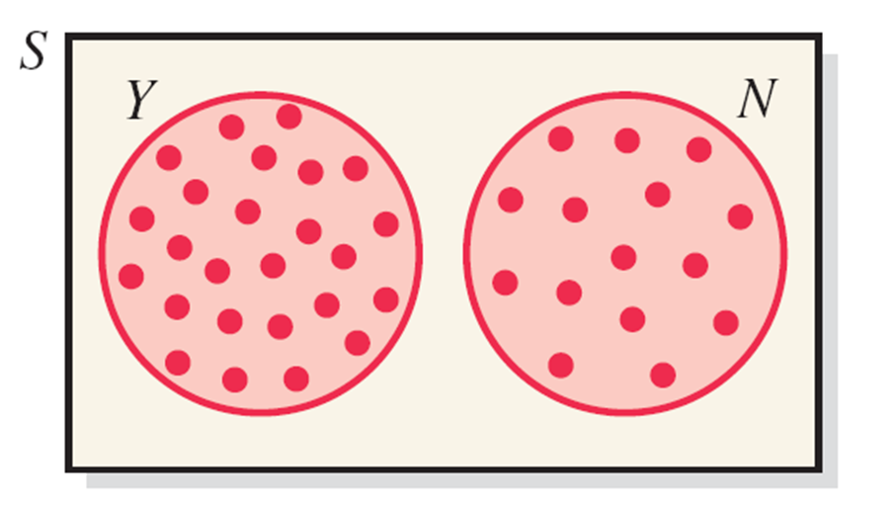
Example 4-15: Solution
As we can observe from the definitions of events Y and N and from Figure 4.8 events Y and N have no common outcome. Hence, these two events are mutually exclusive.

Slide 63
Marginal Probability, Conditional Probability, and Related Probability Concepts (5 of 6)
Definition
Two events are said to be independent if the occurrence of one does not affect the probability of the occurrence of the other. In other words, A and B are independent events if
either P(A | B) = P(A) or P(B | A) = P(B)

Slide 64
Example 4-16
Refer to the information on 100 employees given in Table 4.5 in Section 4.3.1. Are events “in favor” and “female” independent?

Slide 65
Example 4-16: Solution
To check whether events in favor and female are independent, we find the (marginal) probability of in favor, and then the conditional probability of in favor given that female has already happened. If these two probabilities are equal then these two events are independent, otherwise they are dependent.
From Table 4.5, we compute the following two probabilities:
P (in favor) = 19/100 = .19 and
P (in favor | female) = 4/40 = .1
Because these two probabilities are not equal, the two events are dependent.

Slide 66
Example 4-17
In a survey, 500 randomly selected adults who drink coffee were asked whether they usually drink coffee with or without sugar. Of these 500 adults, 240 are men, and 175 drink coffee without sugar. Of the 240 men, 84 drink coffee without sugar. Are the events drinking coffee without sugar and man independent?

Slide 67
Example 4-17: Solution
To check if the events drinking coffee without sugar and man are independent, first we find the probability that a randomly selected adult from these 500 adults drinks coffee without sugar and then find the conditional probability that this selected adult drinks coffee without sugar given that this adult is a man.
From the given information:
P (drinks coffee without sugar) = 175/500 = .35 and
P (drinks coffee without sugar | man) = 84/240 = .35
Because these two probabilities are equal, the two events drinking coffee without sugar and man are independent.

Slide 68
Example 4-17: Solution Table 4.7 Gender and Drinking Coffee with or without Sugar
Table 4.7 Gender and Drinking Coffee with or without Sugar
 | With sugar | Without Sugar | Total
Male | 156 | 84 | 240
Women | 169 | 91 | 260
Total | 325 | 175 | 500

Slide 69
Marginal Probability, Conditional Probability, and Related Probability Concepts (6 of 6)
Definition
The complement of event A, denoted by
and read as “A bar” or “A complement,” is the event that includes all the outcomes for an experiment that are not in A.

Slide 70
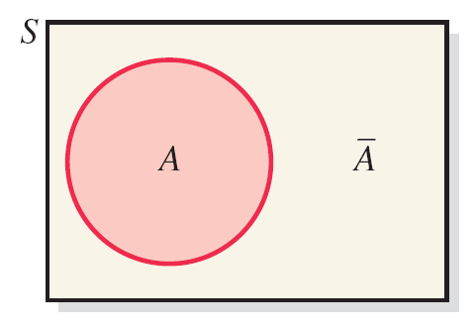
Figure 4.9 Two Complementary Events

Slide 71
Example 4-18
In a group of 2000 taxpayers, 400 have been audited by the IRS at least once. If one taxpayer is randomly selected from this group, what are the two complementary events for this experiment, and what are their probabilities?

Slide 72
Example 4-18: Solution
The two complementary events for this experiment are
A = the selected taxpayer has been audited by the IRS at least once
= the selected taxpayer has never been audited by the IRS
The probabilities of the complementary events are
P (A) = 400/2000 = .20 and
P
= 1600/2000 = .80

Slide 73
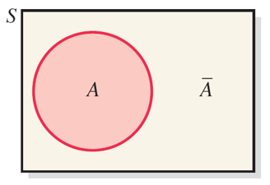
Figure 4.10 Complementary Events A and

Slide 74
Example 4-19
Refer to the information given in Table 4.7. Of the 500 adults, 325 drink coffee with sugar. Sup- pose one adult is randomly selected from these 500 adults, and let A be the event that this adult drinks coffee with sugar. What is the complement of event A? What are the probabilities of the two events?

Slide 75
Example 4-19: Solution
The two complementary events for this experiment are
A = the selected adult drinks coffee with sugar
= the selected adult drinks coffee without sugar
The probabilities of the complementary events are
P(A) = 325/500 = .65 and
= 175/500 = .35
Also we can observe, the sum of these two probabilities is 1,
which should be the case with two complementary events.
Also, once we find P(A), we can find
as:
= 1 – P(A) = 1 – .65 = .35

Slide 76
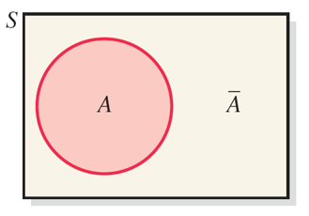
Figure 4.11 Complementary Events Drinking Coffee with or without Sugar

Slide 77
4.4. Intersection of Events and the Multiplication Rule
Intersection of Events
Definition
Let A and B be two events defined in a sample space. The intersection of A and B represents the collection of all outcomes that are common to both A and B and is denoted by
(A and B)

Slide 78
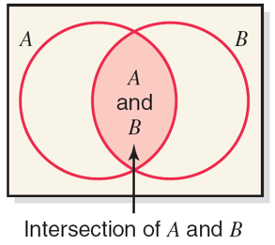
Figure 4.12 Intersection of Events A and B

Slide 79
Intersection of Events and the Multiplication Rule (1 of 3)
Multiplication Rule
Definition
The probability of the intersection of two events is called their joint probability. It is written as
P(A and B)

Slide 80
Intersection of Events and the Multiplication Rule (2 of 3)
Multiplication Rule to Calculate the Probability of Independent Events
The probability of the intersection of two independent events A and B is
P(A and B) = P(A) × P(B)

Slide 81
Example 4-20
An office building has two fire detectors. The probability is .02 that any fire detector of this type will fail to go off during a fire. Find the probability that both of these fire detectors will fail to go off in case of a fire. Assume that these two fire detectors are independent of each other.

Slide 82
Example 4-20: Solution
We define the following two events:
A = the first fire detector fails to go off during a fire
B = the second fire detector fails to go off during a fire
Then, the joint probability of A and B is
P(A and B) = P(A) × P(B) = (.02) × (.02) = .0004

Slide 83
Example 4-21
The probability that a college graduate will find a full-time job within three months after graduation from college is .27. Three college students, who will be graduating soon, are randomly selected. What is the probability that all three of them will find full-time jobs within three months after graduation from college?

Slide 84
Example 4-21: Solution
Let A, B, and C denote the events the first, second, and third student, respectively, finds a full-time job within three months after graduation from college. Hence,
P (A and B and C) = P(A) × P(B) × P(C)
= (.27) × (.27) × (.27) = .0197

Slide 85
Intersection of Events and the Multiplication Rule (3 of 3)
Multiplication Rule to Find Joint Probability of Two Dependent Events
The probability of the intersection of two dependent events A and B is
P(A and B) = P(A) × P(B |A) or P(B) × P(A |B)

Slide 86
Example 4-22 (1 of 2)
Table 4.8 gives the classification of all employees of a company given by gender and college degree.
 | College Graduate (G) | Not a College Graduate (N) | Total
Male (M) | 7 | 20 | 27
Female (F) | 4 | 9 | 13
Total | 11 | 29 | 40

Slide 87
Example 4-22 (2 of 2)
If one of these employees is selected at random for membership on the employee-management committee, what is the probability that this employee is a female and a college graduate?

Slide 88
Example 4-22: Solution
We are to calculate the probability of the intersection of the events female and college graduate.
P(female) = 13/40
P(college graduate | female) = 4/13
P(female and college graduate)
= P(female) × P(college graduate | female)
= (13/40) × (4/13) = .10

Slide 89
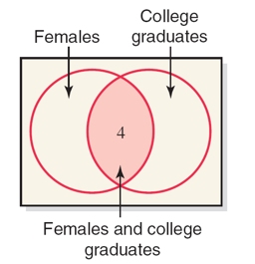
Figure 4.13 Intersection of Events Female and College Graduate

Slide 90
Example 4-23
In a group of 20 college students, 7 like ice tea and others do not. Two students are randomly selected from this group.
Find the probability that both of the selected students like ice tea.
Find the probability that the first student selected likes ice tea and the second does not.

Slide 91
Example 4-23: Solution (1 of 2)
From the given information:
P(first student likes ice tea) = 7/20 = .35
P(second student likes ice tea ∣ first student likes ice tea)
= 6/19 = .3158
Thus, the joint probability of the two events is:
P(both students like ice tea)
= P(first student likes ice tea) ×
P(second student likes ice tea ∣ first student likes ice tea)
= (.35) × (.3158) = .1105

Slide 92
Example 4-23: Solution (2 of 2)
From the given information:
P(1st student likes ice tea) = 7/20 = .35
P(2nd student does not like ice tea ∣ 1st student likes ice tea)
= 13/19 = .6842
Thus, the joint probability of the two events is:
P(1st student likes ice tea and 2nd student does not like it)
= P(1st student likes ice tea) ×
P(2nd student does not like it ∣ 1st student likes ice tea)
= (.35) × (.6842) = .2395

Slide 93
Intersection of Events and the Multiplication Rule
Calculating Conditional Probability
If A and B are two events, then,
given that P (A ) ≠ 0 and P (B ) ≠ 0.

Slide 94
Example 4-24
The probability that a randomly selected student from a college is a senior is .20, and the joint probability that the student is a computer science major and a senior is .03. Find the conditional probability that a student selected at random is a computer science major given that the student is a senior.

Slide 95
Example 4-24: Solution
From the given information,
P(senior) = .20 and
P(senior and computer science major) = .03
Hence,
P(computer science major | senior)
= P(senior and computer science major) / P(senior)
= .03 / .20 = .15

Slide 96
Mutually Exclusive Events
Joint Probability of Mutually Exclusive Events
The joint probability of two mutually exclusive events is always zero. If A and B are two mutually exclusive events, then
P(A and B) = 0

Slide 97
Example 4-25
Consider the following two events for an application filed by a person to obtain a car loan:
A = event that the loan application is approved
R = event that the loan application is rejected
What is the joint probability of A and R?

Slide 98
Example 4-25: Solution
The two events A and R are mutually exclusive. Either the loan application will be approved or it will be rejected. Hence,
P(A and R) = 0

Slide 99
4.5 Union of Events and the Addition Rule
Definition
Let A and B be two events defined in a sample space. The union of events A and B is the collection of all outcomes that belong to either A or B or to both A and B and is denoted by
(A or B)

Slide 100
Example 4-26
All 440 employees of a company were asked what hot drink they like the most. Their responses are listed in Table 4.9.
Describe the union of events female and likes regular coffee.

Slide 101
Table 4.9 Hot Drinks Employees Like
Table 4.9 Hot Drinks Employees Like
 | Regular Coffee | Regular Tea | Other | Total
Male | 110 | 70 | 110 | 290
Female | 60 | 50 | 40 | 150
Total | 170 | 120 | 150 | 440

Slide 102
Example 4-26: Solution
The union of events female and likes regular coffee includes those employees who are either female or like regular coffee or both. As we can observe from Table 4.9, there are a total of 150 females in these employees, and 170 of all employees like regular coffee.
Thus, the number of employees who are either female or like regular coffee or both is:
150+ 170 − 60 = 260
These 260 employees give the union of events female and likes regular coffee, which is shown in Figure 4.14.

Slide 103
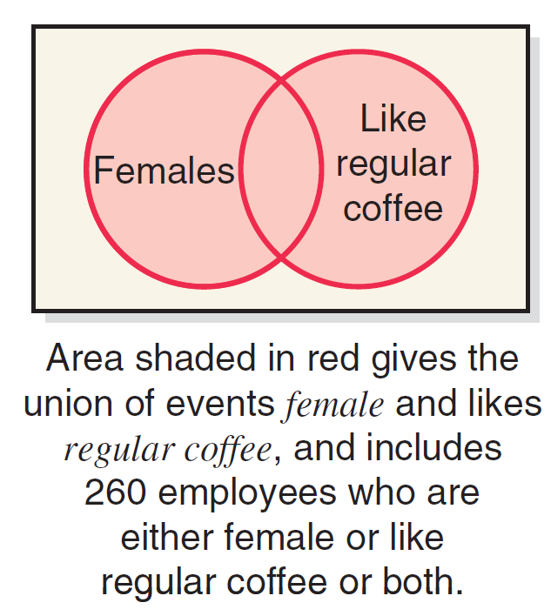
Figure 4.14 Union of Events Female and Likes Regular Coffee

Slide 104
Addition Rule for Mutually Nonexclusive Events
Addition Rule
Addition Rule to Find the Probability of Union of Two Mutually Nonexclusive Events
The portability of the union of two mutually nonexclusive events A and B is
P(A or B) = P(A) + P(B) – P(A and B)

Slide 105
Example 4-27
A university president has proposed that all students must take a course in ethics as a requirement for graduation. Three hundred faculty members and students from this university were asked about their opinion on this issue. Table 4.10 gives a two-way classification of the responses of these faculty members and students.
Find the probability that one person selected at random from these 300 persons is a faculty member or is in favor of this proposal.

Slide 106
Table 4.10 Two-Way Classification of Responses
 | Favor | Oppose | Neutral | Total
Faculty | 45 | 15 | 10 | 70
Student | 90 | 110 | 30 | 230
Total | 135 | 125 | 40 | 300

Slide 107
Example 4-27: Solution
From the information in the Table 4.10,
P(faculty) = 70/300 = .2333
P(in favor) = 135/300 = .4500
P(faculty and in favor) = 45/300 = .1500
Using the addition rule, we obtain
P(faculty or in favor)
= P(faculty) + P(in favor) − P(faculty and in favor)
= .2333 + .4500 – .1500 = .5333

Slide 108
Example 4-28
In a group of 2500 persons, 1400 are female, 600 are vegetarian, and 400 are female and vegetarian. What is the probability that a randomly selected person from this group is a male or vegetarian?

Slide 109
Example 4-28: Solution
From the information in the Table 4.11,
P(male) = 1100/2500 = .44
P(vegetarian) = 600/2500 = .24
P(male and vegetarian) = 200/2500 = .08
Using the addition rule, we obtain
P(male or vegetarian)
= P(male) + P(vegetarian) − P(male and vegetarian)
= .44 + .24 – .08 = .60

Slide 110
Addition Rule for Mutually Exclusive Events
Addition Rule to Find the Probability of the Union of Mutually Exclusive Events
The probability of the union of two mutually exclusive events A and B is
P(A or B) = P(A) + P(B)

Slide 111
Example 4-29
Refer to Example 4–27. A university president proposed that all students must take a course in ethics as a requirement for graduation. Three hundred faculty members and students from this university were asked about their opinion on this issue. The following table, reproduced from Table 4.10 in Example 4–27, gives a two-way classification of the responses of these faculty members and students.
What is the probability that a randomly selected person from these 300 faculty members and students is in favor of the proposal or is neutral?

Slide 112
Example 4-29: Solution (1 of 2)
Table 4.10 Two-Way Classification of Responses
 | Favor | Oppose | Neutral | Total
Faculty | 45 | 15 | 10 | 70
Student | 90 | 110 | 30 | 230
Total | 135 | 125 | 40 | 300

Slide 113
Example 4-29: Solution (2 of 2)
From the given information,
P(in favor) = 135/300 = .4500
P(neutral) = 40/300 = .1333
Hence,
P(in favor or neutral) = .4500 + .1333 = .5833

Slide 114
Example 4-30
Consider the experiment of rolling a die once. What is the probability that a number less than 3 or a number greater than 4 is obtained?

Slide 115
Example 4-30: Solution (1 of 2)
Here, the event a number less than 3 is obtained happens if either 1 or 2 is rolled on the die, and the event a number greater than 4 is obtained happens if either 5 or 6 is rolled on the die. Thus, these two events are mutually exclusive as they do not have any common outcome and cannot happen together. Hence, their joint probability is zero.
P(a number less than 3 is obtained) = 2/6
P(a number greater than 4 is obtained) = 2/6

Slide 116
Example 4-30: Solution (2 of 2)
The probability of the union of these two events is:
P(a number less than 3 is obtained or a number greater than 4 is obtained) = 2/6 + 2/6 = .6667

Slide 117
4.6 Counting Rule, Factorials, Combinations, and Permutations
Counting Rule to Find Total Outcomes
If an experiment consists of three steps and if the first step can result in m outcomes, the second step in n outcomes, and the third in k outcomes, then
Total outcomes for the experiment = m • n • k

Slide 118
Example 4-31
Consider three tosses of a coin. How many total outcomes this experiment has?

Slide 119
Example 4-31: Solution
This experiment of tossing a coin three times has three steps: the first toss, the second toss, and the third toss. Each step has two outcomes: a head and a tail. Thus,
Total outcomes for three tosses of a coin = 2 × 2 × 2 = 8
The eight outcomes for this experiment are
HHH, HHT, HTH, HTT, THH, THT, TTH, and TTT

Slide 120
Example 4-32
A prospective car buyer can choose between a fixed and a variable interest rate and can also choose a payment period of 36 months, 48 months, or 60 months. How many total outcomes are possible?

Slide 121
Example 4-32: Solution
There are two outcomes (a fixed or a variable interest rate) for the first step and three outcomes (a payment period of 36 months, 48 months, or 60 months) for the second step. Hence,
Total outcomes = 2 × 3 = 6

Slide 122
Example 4-33
A National Football League team will play 16 games during a regular season. Each game can result in one of three outcomes: a win, a loss, or a tie. How many total outcomes are possible?

Slide 123
Example 4-33: Solution
The total possible outcomes for 16 games are calculated as follows:
Total outcomes = 3·3·3·3·3·3·3·3·3·3·3·3 ·3·3·3·3
= 3¹⁶ = 43,046,721
One of the 43,046,721 possible outcomes is all 16 wins.

Slide 124
Counting Rule, Factorials, Combinations, and Permutations (1 of 2)
Factorials
Definition
The symbol n!, read as “n factorial,” represents the product of all the integers from n to 1. In other words,
n! = n(n − 1)(n − 2)(n − 3) · · · 3 · 2 · 1
By definition,
0! = 1

Slide 125
Example 4-34
Evaluate 7!
7! = 7 · 6 · 5 · 4 · 3 · 2 · 1 = 5040

Slide 126
Example 4-35
Evaluate 10!
10! = 10 · 9 · 8 · 7 · 6 · 5 · 4 · 3 · 2 · 1
= 3,628,800

Slide 127
Example 4-36
Evaluate (12-4)!
(12-4)! = 8! = 8 · 7 · 6 · 5 · 4 · 3 · 2 · 1
= 40,320

Slide 128
Example 4-37
Evaluate (5-5)!
(5-5)! = 0! = 1
Note that 0! is always equal to 1.

Slide 129
Counting Rule, Factorials, Combinations, and Permutations (2 of 2)
Combinations
Definition
Combinations give the number of ways x elements can be selected from n elements. The notation used to denote the total number of combinations is
_{n}C_{x}
which is read as “the number of combinations of n elements selected x at a time.”

Slide 130
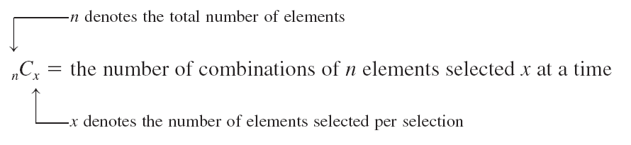
Combinations (1 of 2)

Slide 131
Combinations (2 of 2)
Number of Combinations
The number of combinations for selecting x from n distinct elements is given by the formula
where n!, x!, and (n-x)! are read as “n factorial,” “x factorial,” “n minus x factorial,” respectively.

Slide 132
Example 4-38
An ice cream parlor has six flavors of ice cream. Kristen wants to buy two flavors of ice cream. If she randomly selects two flavors out of six, how many combinations are there?

Slide 133
Example 4-38: Solution
n = total number of ice cream flavors = 6
x = number of ice cream flavors to be selected = 2
Thus, there are 15 ways for Kristen to select two ice cream flavors out of six.

Slide 134
Example 4-39
Three members of a committee will be randomly selected from five people. How many different combinations are possible?

Slide 135
Example 4-39: Solution
n = 5 and x = 3

Slide 136
Example 4-40
Marv & Sons advertised to hire a financial analyst. The company has received applications from 10 candidates who seem to be equally qualified. The company manager has decided to call only 3 of these candidates for an interview. If she randomly selects 3 candidates from the 10, how many total selections are possible?

Slide 137
Example 4-40: Solution
n = 10 and x = 3
Thus, the company manager can select 3 applicants from 10 in 120 ways.

Slide 138
Case Study 4-2 Probability of Winning a Mega Millions Lottery Jackpot
Number of white balls matched | Number of gold balls matched | Prize | Number of white balls matched | Number of gold balls matched | Prize
5 | 1 | Jackpot | 3 | 0 | $5
5 | 0 | $1,000,000 | 2 | 1 | $5
4 | 1 | $5,000 | 1 | 1 | $2
4 | 0 | $500 | 0 | 1 | $1
3 | 1 | $50

Slide 139
Permutations (1 of 2)
Permutations Notation
Permutations give the total selections of x element from n (different) elements in such a way that the order of selections is important. The notation used to denote the permutations is
_{n}P_{x}
which is read as “the number of permutations of selecting x elements from n elements.” Permutations are also called arrangements.

Slide 140
Permutations (2 of 2)
Permutations Formula
The following formula is used to find the number of permutations or arrangements of selecting x items out of n items. Note that here, the n items must all be different.

Slide 141
Example 4-41
A club has 20 members. They are to select three office holders – president, secretary, and treasurer – for next year. They always select these office holders by drawing 3 names randomly from the names of all members. The first person selected becomes the president, the second is the secretary, and the third one takes over as treasurer. Thus, the order in which 3 names are selected from the 20 names is important. Find the total arrangements of 3 names from these 20.

Slide 142
Example 4-41: Solution
n = total members of the club = 20
x = number of names to be selected = 3
Thus, there are 6840 permutations or arrangements for selecting 3 names out of 20.

Slide 143
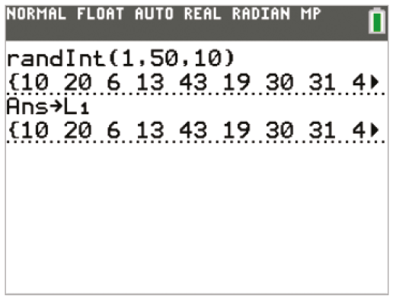
TI-84 Color/TI-84 (1 of 2)

Slide 144
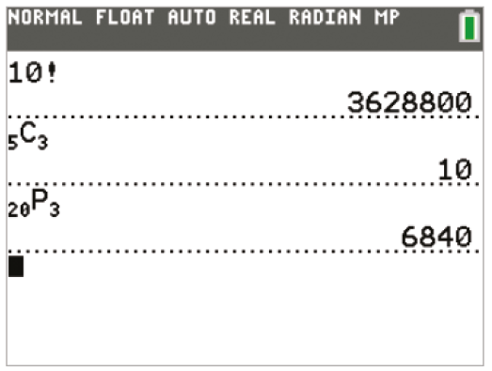
TI-84 Color/TI-84 (2 of 2)

Slide 145
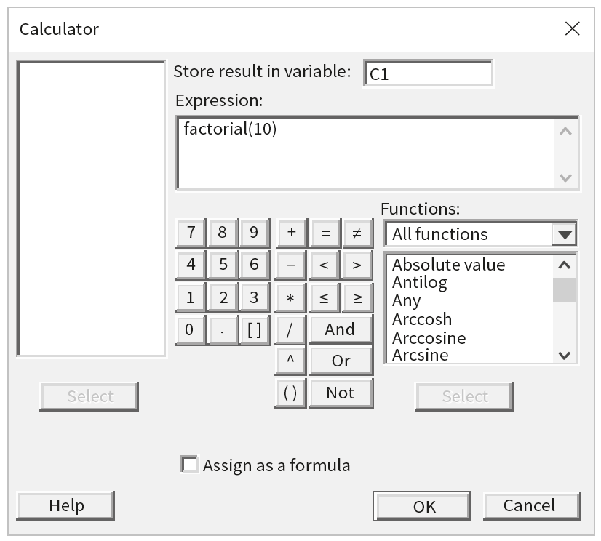
Minitab (1 of 2)

Slide 146
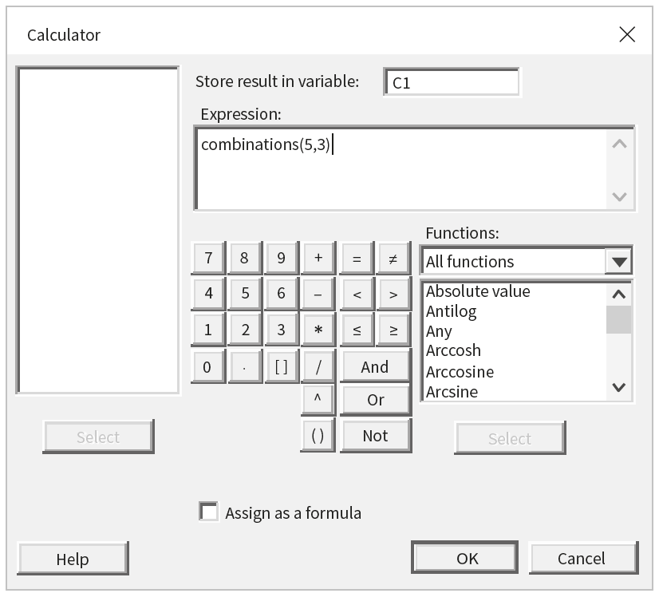
Minitab (2 of 2)

Slide 147
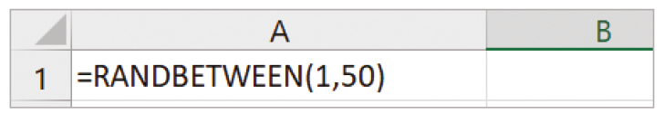
Excel (1 of 2)

Slide 148

Excel (2 of 2)

Slide 149
Copyright
Copyright © 2021 John Wiley & Sons, Inc.
All rights reserved. Reproduction or translation of this work beyond that permitted in Section 117 of the 1976 United States Act without the express written permission of the copyright owner is unlawful. Request for further information should be addressed to the Permissions Department, John Wiley & Sons, Inc. The purchaser may make back-up copies for his/her own use only and not for distribution or resale. The Publisher assumes no responsibility for errors, omissions, or damages, caused by the use of these programs or from the use of the information contained herein.

